Slide 1
Analysis of Social Media and Speeches in Indian Politics
Name: Leo K A
Bits Id: 2018HT12021

Slide 2
Contents
Introduction
Existing Architecture
Objective
Requirement Analysis
Sentiment Analysis Challenges
Methodology & Implementation
Proposed Technique
Result and Analysis
Conclusion

Slide 3
Introduction
What is Sentiment analysis ?
Sentiment analysis refers to the application of natural language processing, computational linguistics, and text analytics to identify and extract subjective information in source materials.
Most important sources of decision making.
Social Media In current scenario a huge population of world is expressing their view and opinion for government policies or for any social issue through social media. Peoples are also expressing their opinion on social media openly what kind of polices, governance etc. they want from ruling parties.
Predicate and Analysis
Machine learning and artificial intelligence are emerging technology of current time and model to predict the results of important political elections or predict the sentiment on speeches as well as polls is also an emerging application to sentiment analysis.

Slide 4
Existing Architecture
The previous work on projects can be categories into two groups:
Sentiment analysis research on general domain.
Sentiment analysis research on political domain.
Sentiment Analysis on General Domain
Hotel reviews, Product review for mobile device and evaluates the quality of scientific papers
Sentiment Analysis on Political Domain
2009 federal election of Germany and Trump Vs, Clinton 2016.
Some algorithms used are K-nearest neighbor, Classifier, Random forest and Naïve Base, both supervised and unsupervised learning to evaluate the sentiments accuracy.

Slide 5
Objective
This project aim to get the sentiment on speeches of political leader which were delivered during the election campaigning and also on tweets by the leader and their political affiliated party.
And help in to find out which kind of the speech has been delivered and how the peoples are reacting.
This project will group the speech words in “Anger”, “anticipation”, “disgust”, “joy”, “Fear”, “sadness”, “surprise”, “trust”, “positive”, and “negative” categories by using NLP and display the percent emotions keywords which were used in speech.
On tweets Dataset we are finding the tweet sentiment whether the tweets are negative positive or neutral.
In the project I created model to predict the sentiment of the tweets. And this model will help in to predict the sentiment and what is the accuracy by using two machine learning algorithms. By using word cloud we can also find out keyword by this project. And this will help use to understand what are the top priory of the leader.

Slide 6
Requirement Analysis
Sentiment analysis goals to find out the speaker attitude, writer, or other subject with respect to some topic or the overall contextual polarity or emotional reaction to a document, interaction, or event.
It refers to the use of NLP, analysis of text computational linguistics, biometric which is used in systematic identification , extract, study affective states, quantification, and subjective information.
Sentiment analysis refers to the application of NLP, computational linguistics, and text analytics to identify and extract subjective information in source materials.

Slide 7
Requirement Analysis (Contd.)
Natural Language
Computational Linguistics
Text Analytics
Types of Sentiment Analysis
Objectivity and/or subjective identification sentiment analysis.
Feature and/or aspect based sentiment analysis.
Current Sentiment analysis Approaches can be categories in following three group:
Statistical approaches
Lexicon/Knowledge-based approaches
Hybrid approaches

Slide 8





Sentiment Analysis Approaches/Methods
Statistical/Machine
Knowledge/
Hybrid
Learning Based
Lexicon Based
Approaches
Approaches
Approaches
Supervised Learning
Sentiment Analysis Approaches/Methods
Semi
-
Supervised Learning
Unsupervised
Learning

Slide 9
Sentiment Analysis Challenges
Following are some of the major challenges which were faced in sentiment analysis:
Incremental Approach
Parallel Computing For Massive Data
Behavior/Homophily/ Credibility
Sarcasm
Author Segmentation review
Grammatical Error
Existing Lexicons refinement
System designed for specific language
Handling Noise & Dynamism

Slide 10
Methodology & Implementation
Sentiment analysis on speech and the impact of the speech on election results.
In this project we perform sentiment analysis on political speeches which are available in public domain. And then we analyze the impact of speech on people through tweets.
Political Speeches
To win the election candidate influence people by speech or by making promises to do when he gets power. So the speeches which involve political interests are political speeches.
Tweets
We are using leaders and their party tweets to extract the hashtag as well as to analysis of sentiment

Slide 11
Proposed Technique
For this project I have taken two top Indian leaders Narendra Modi and Rahul Gandhi public speeches for the election campaigning and tweets from their official twitter handle during the election. And also extract tweets from their party twitter handle, Narendra Modi represents the Bharti Janta Party and Rahul Gandhi to Indian National Congress Party. The basic process of sentiment analysis is natural language process or NLP.

Slide 12
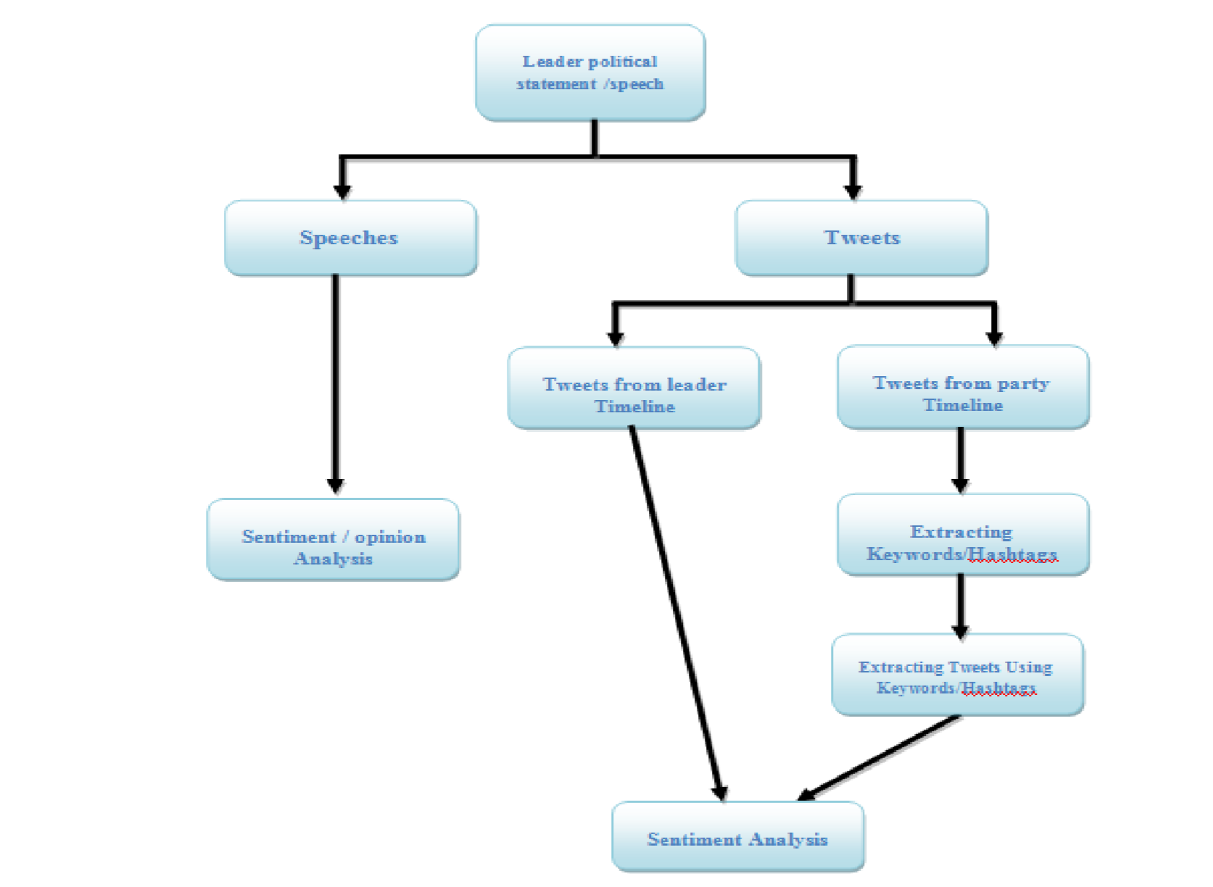
Flow Diagram of analysis

Slide 13
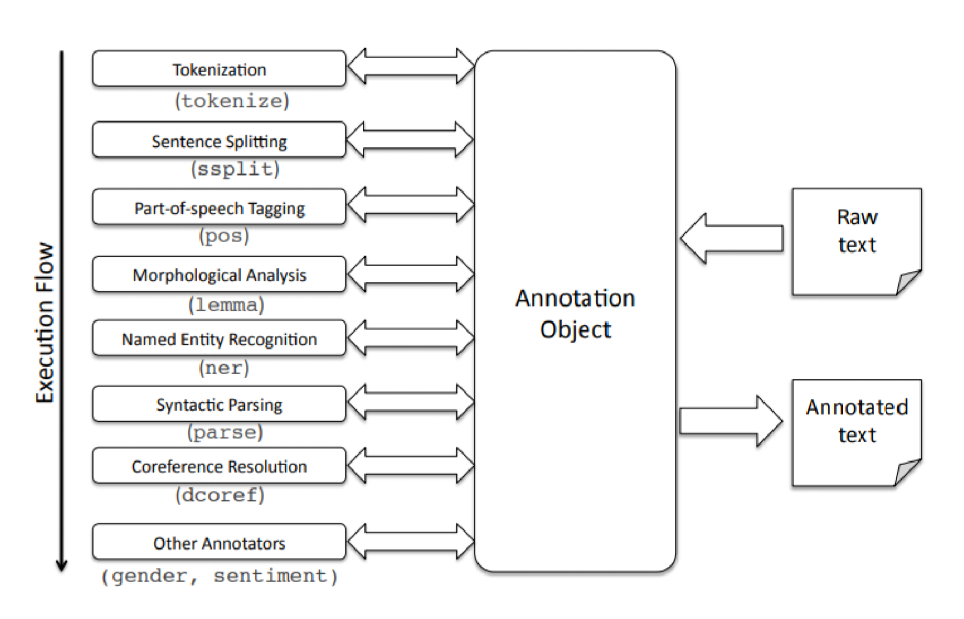
Models
Natural Language Processing:
NLP is most reliable technique of sentiment analysis of opinion mining of text. Extracts sentiment and sentiment-derived plot arcs from text using three sentiment dictionaries
Afinn
Bing
Nrc
In the R language all above dictionaries are integrated in syuzhet package.
Stanford CoreNLP
This toolkit includes the part-of-speech (POS) tagger,
the named entity recognizer (NER), the parser, the coreference
resolution system, sentiment analysis, bootstrapped pattern
learning, and the open information extraction tools.

Slide 14
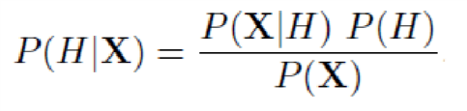
Naïve bayes
In this project we are training are model using the tweets dataset.
And that dataset have two attributes first is text and second one is class. Here class is basically sentiment positive or negative. To find class for the tweets we process the tweets on NLP to get sentiment. Using naïve bayes classifier we can predict how likely a voter or public is to respond positively to a tweet posted on leader timeline.
• P: stands for the probability of the variables within parenthesis.
• P (H): The prior probability of marginal probability of H it’s prior in the sense that it has not yet accounted for the information available in X.
• P (H/X): The conditional probability of H.
• X : posterior probability
• P(X/H): conditional probability of X given H.
• P(X): prior or marginal probability of X, which is normally the evidence. It can also represented as
Posterior=likelihood prior/normalizing constant
The ratio of P(X/H)/P(X) is also called as standardized likelihood.

Slide 15
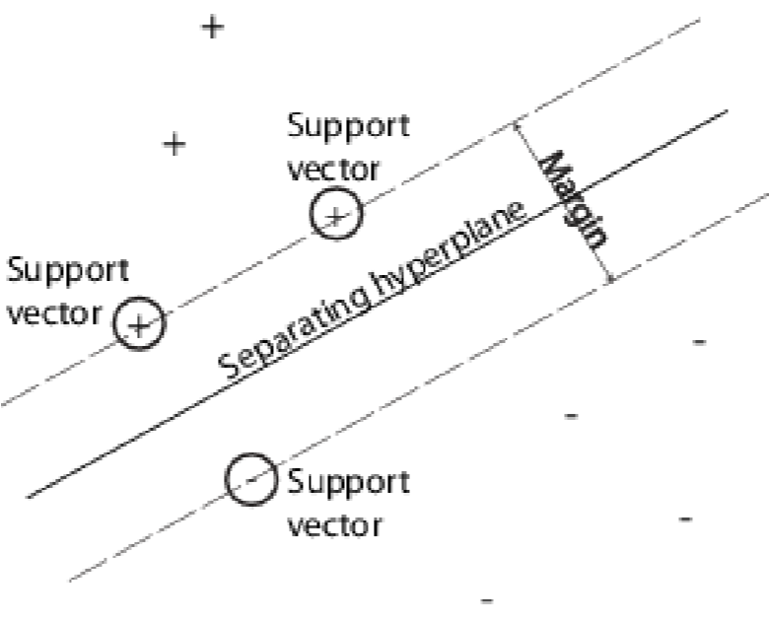
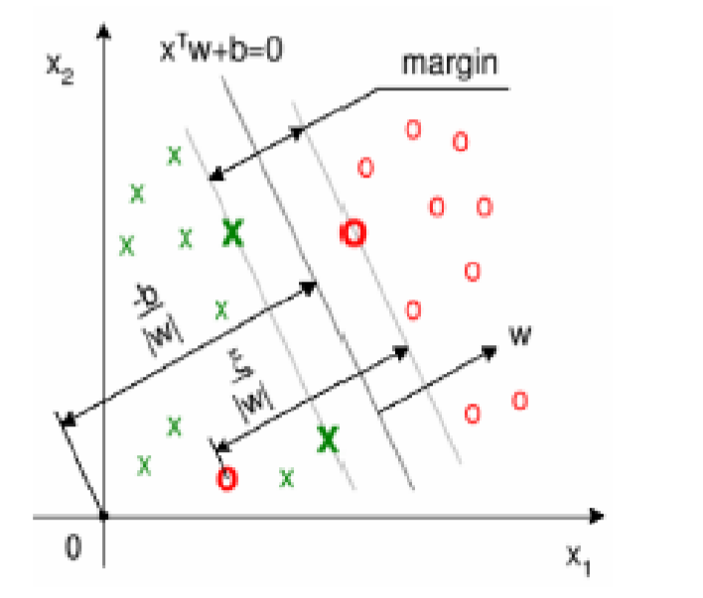
Support vector machine
Support vector machine is a prediction tool for classification and regression that uses ML theory to maximize accuracy for prediction while automatically avoiding over fitting.
An SVM classifies data by finding the best hyper plane that separates all data points of one class from those of the other class. The best hyper plane for an SVM means the one with the largest margin between the two classes .Margin means the maximal width of the slab parallel to the hyper plane that has no interior data points .The support vectors are the data points that are closest to the separating hyper plane; these points are on the boundary of the slab
Geometrical Representation
of the SVM Margin

Slide 16
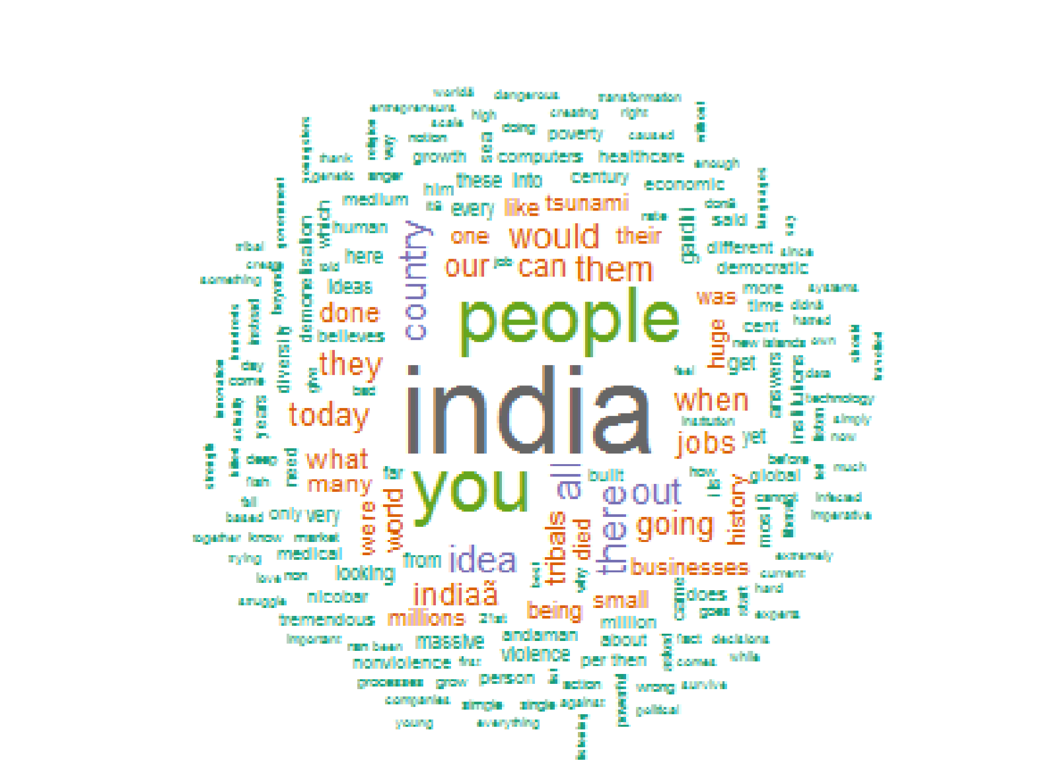
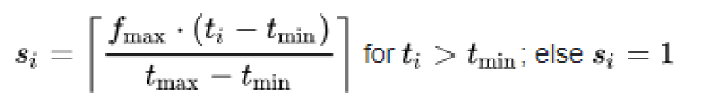
Word Cloud
Word Clouds are a way of showing which word was most significant towards the result and which word appeared frequently. Word clouds are a low-cost alternative for analyzing text from a large amount of textual data. The text is broken into component words and frequency for each is counted.
In a linear normalization, the weight ti of a descriptor is mapped to a size scale of 1 through f, where tmin and tmax are specifying the range of available weights.
• si: display fontsize
• fmax: max. fontsize
• ti: count
• tmin: min. count
• tmax: max. count

Slide 17
Data Preprocessing
For data preprocessing I have performed following steps:
convert text to lowercase
Removal number
Removal punctuation
Remove English stop words
Strip white space
Special character removal

Slide 18
Tools
R : R is a scripting programming language and software environment for statistical analysis, graphics representation and reporting. Used R packages are
twitteR : to connect twitter API and gets tweets.
ROAuth : used to authenticate the API.
plyr : used for common problem of read/write.
stringr : used for simplify the string task or operation
ggplot2 : used for grammar of graphics
RColorBrewer : used to draw nice graph according to variable.
tm : Used to implement machine learning algorithms.
wordcloud : this package is used to make word cloud of words.
Syuzhet: This function is use to get sentiment using NLP
Rstudio
RStudio integrated development environment for R and this software is open source and free for public use.
Tableau
Tableau is a very useful software which makes visualization and analysis very easy.

Slide 19
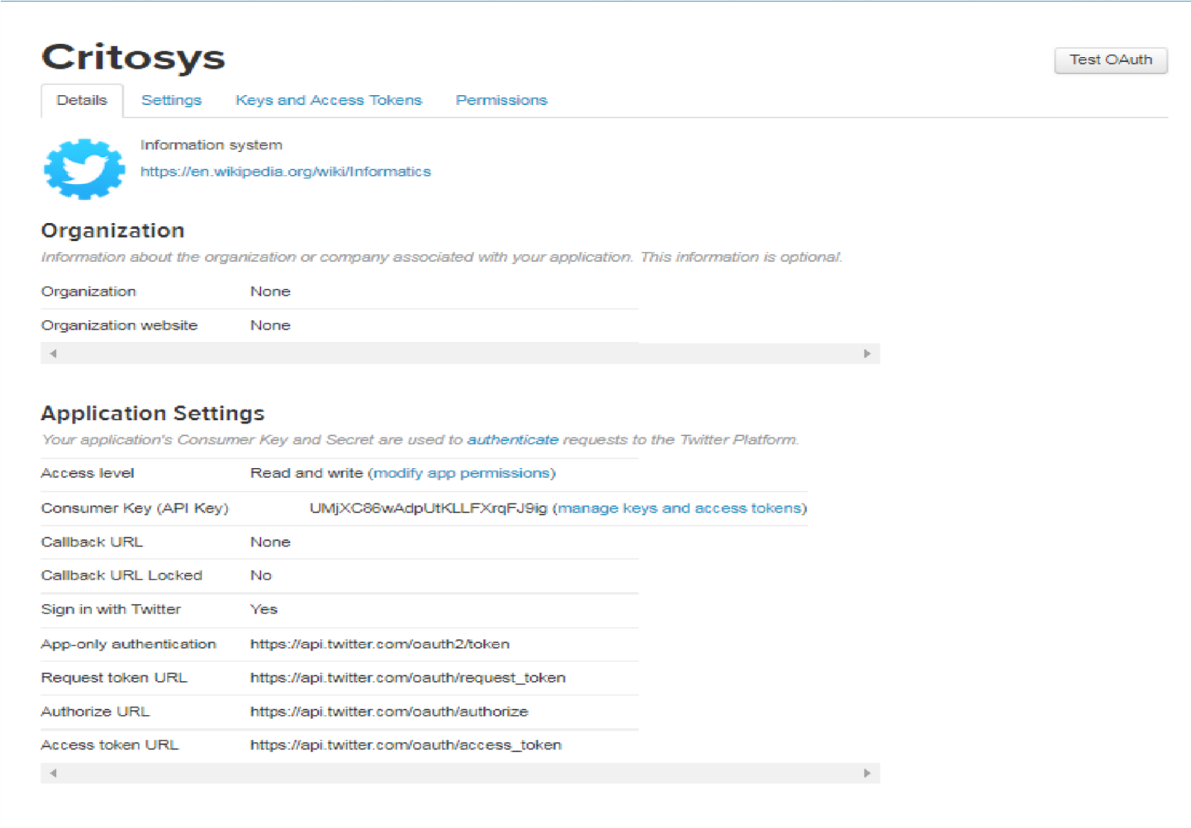
Twitter
For sentiment analysis on tweets we first extract the tweets from twitter using Twitter
API. Between all the different software’s that can be used into analysis for twitter, R provide a wide type of options to do several of interesting and fun things. For this project I have used RStudio as its much easier working with scripts as compared to R. and to extract tweets from twitter we need to create Twitter App.
Creation of Twitter Application
Twitter has made extracting and analyzing tweets
easier by developing an API.
This mainly used to extract tweets. API help us to
extract data in very structure format which can be
then clean and process for further analysis.

Slide 20
Result and Analysis
The election commission of India has announced the date for Karnataka assembly elections on 29th April. Elections will be held in a single phase on May 12 and the results will be announced on May 15. In the Karnataka assembly election top two parties were BJP and INC. In this project we consider speeches of BJP top leader Narendra Modi and Rahul Gandhi from INC. The results of sentiment analysis of their tweets and speech are following.
The results of sentiment analysis of their tweets and speech are following:
Speech and Tweets Analysis
Model to predict tweet sentiment

Slide 21
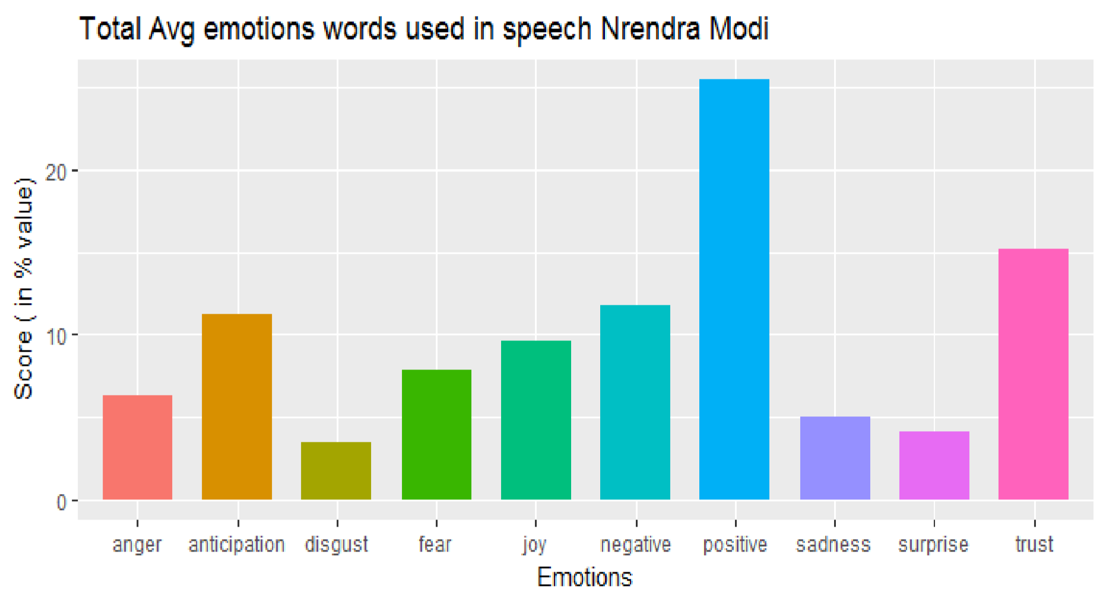
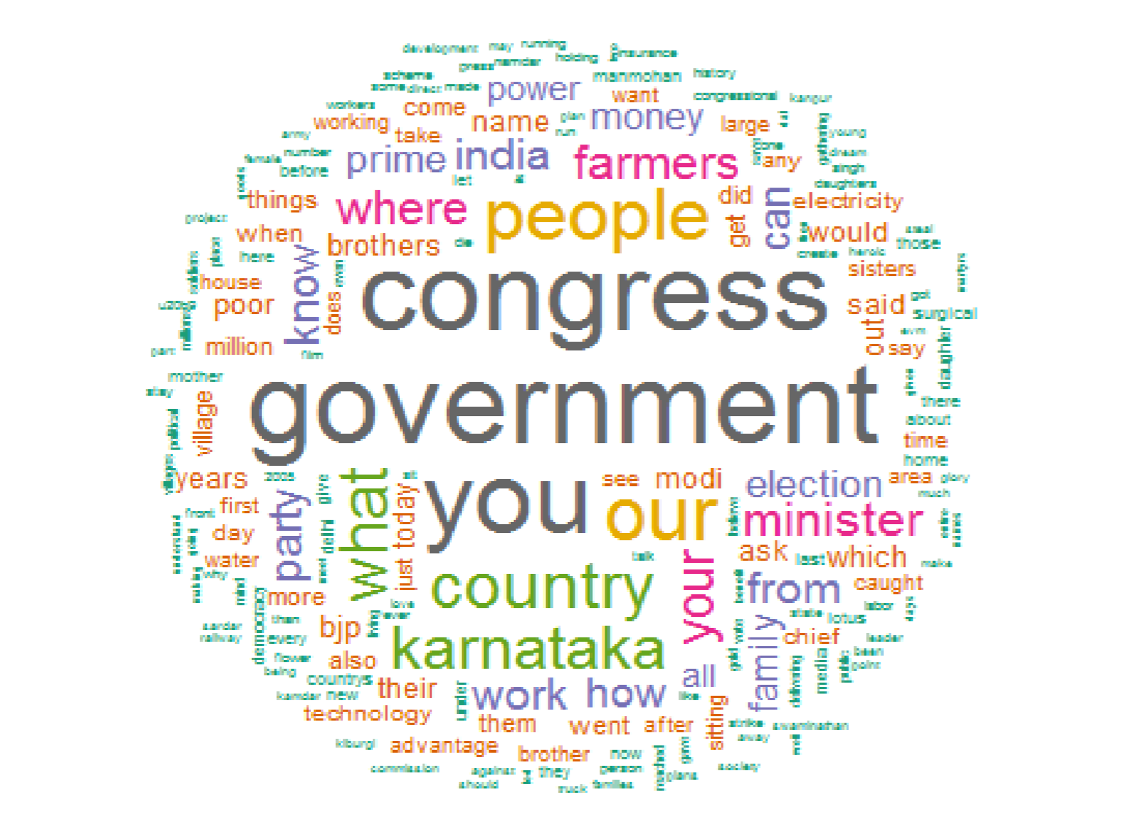
Narendra Modi Speech
25.47
%
15.21
%
11.79
11.28
%
%
9.56
%
7.86
%
6.32
%
4.96
%
3.42
%
4.10
%
Emotions words used in Narendra Modi public speeches
Word cloud of Narendra Modi speeches

Slide 22
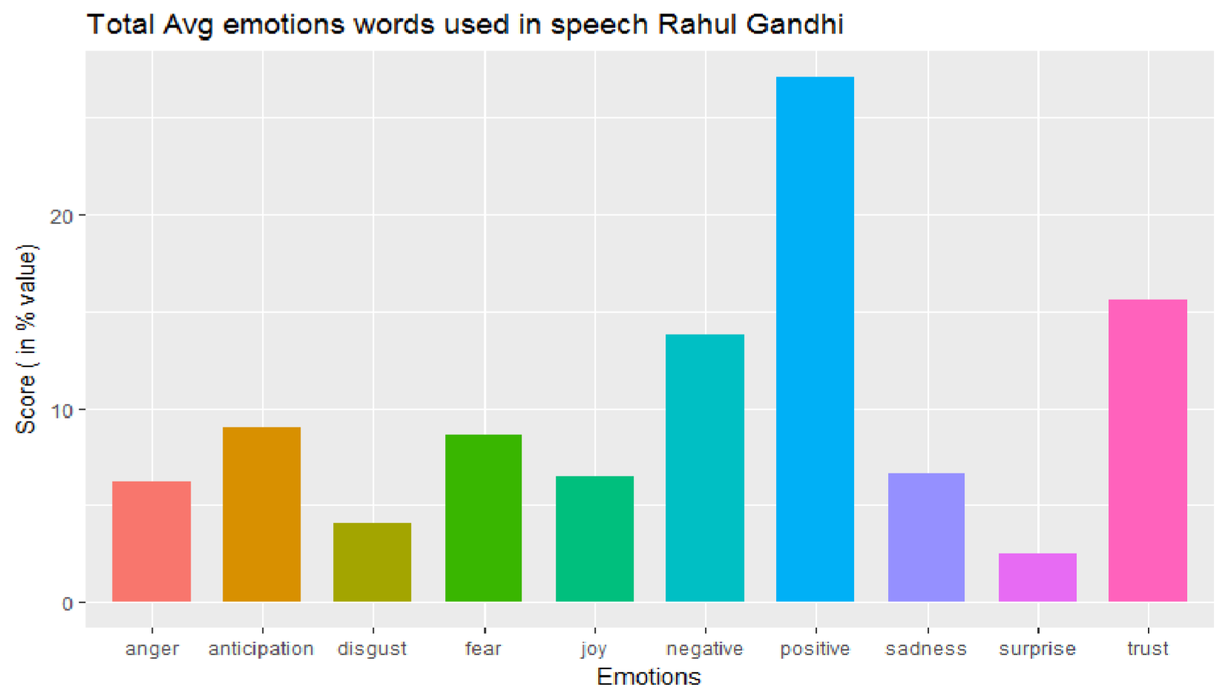
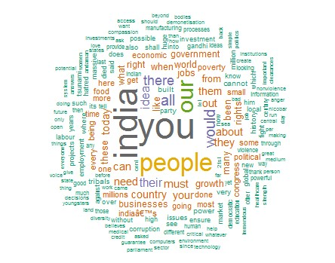
Rahul Gandhi Speech
27.12
%
15.61
%
13.76
%
9
%
8.60
%
6.22
%
6.48
%
6.61
%
4.10
%
2.52
%
:
Emotions words used in Rahul Gandhi public speeches
Word cloud of Rahul Gandhi speeches

Slide 23
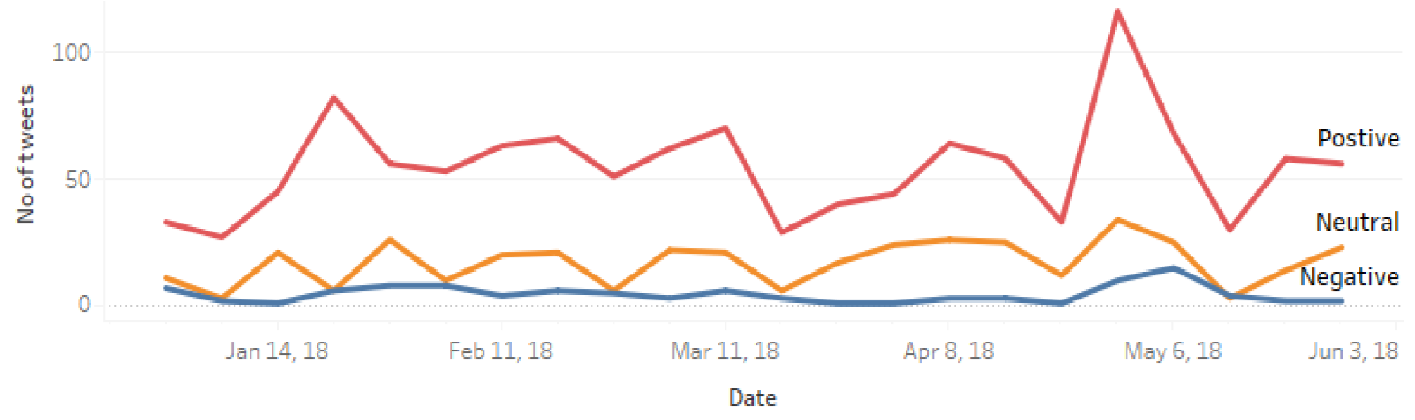
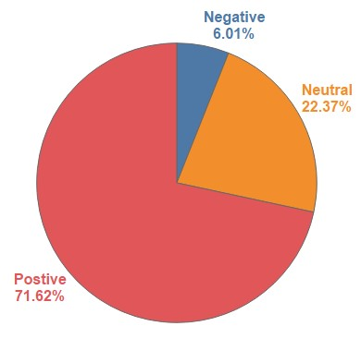
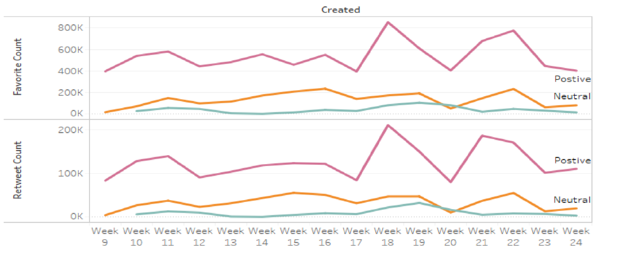
Narendra Modi Twitter Timeline
Trend of positive negative or neutral on time
Pi chart of Total tweets sentiment in %
Trend of favorite and Retweets count

Slide 24
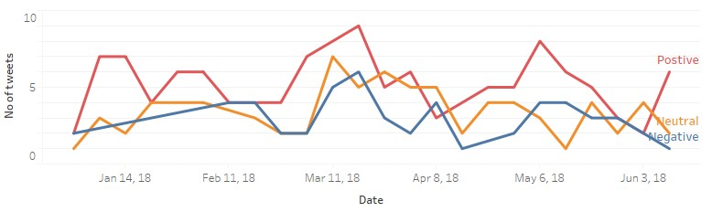
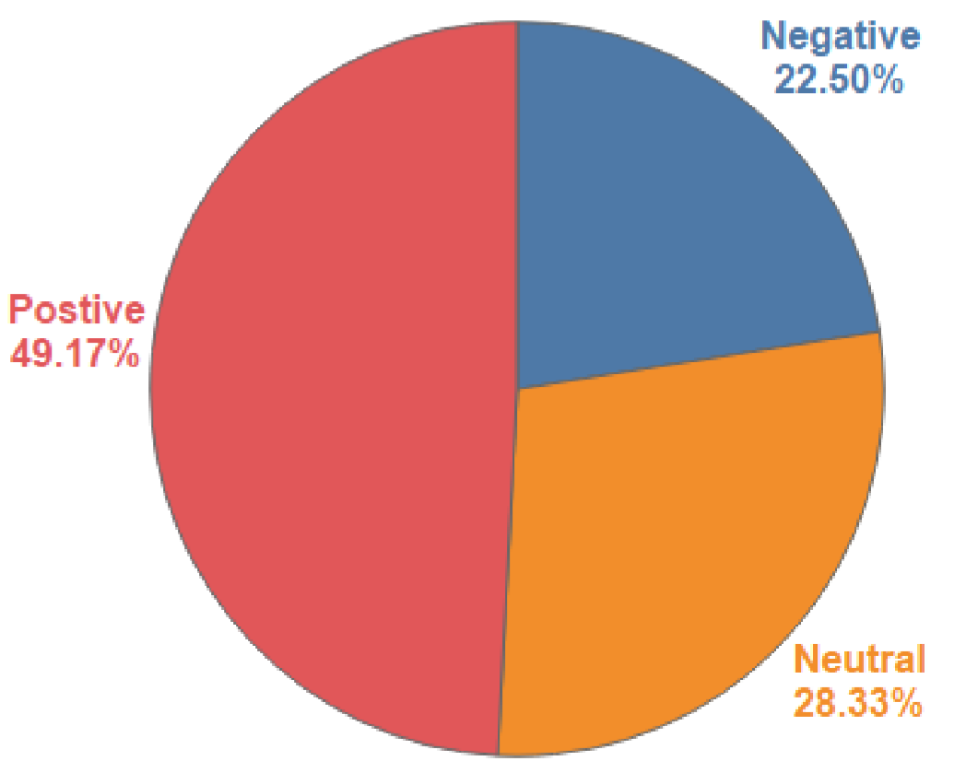
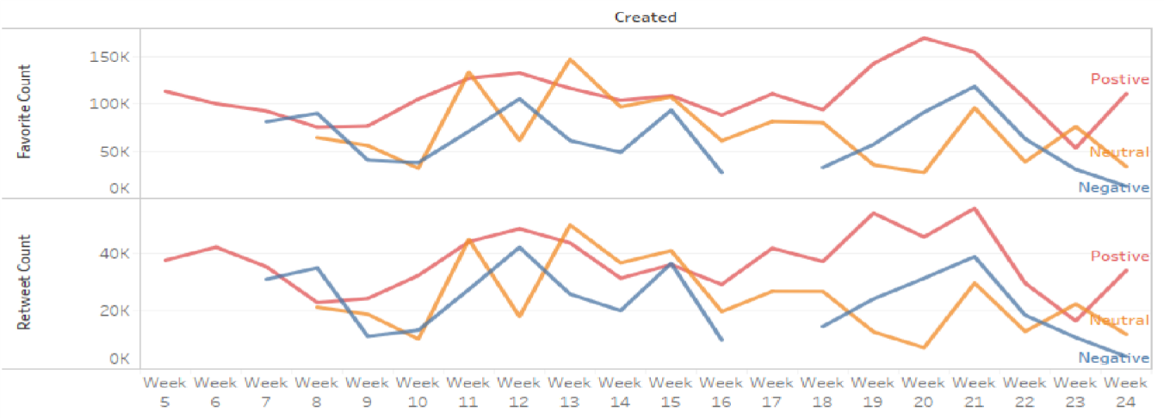
Rahul Gandhi Twitter Timeline
Trend of positive negative or neutral on time
Pi chart of Total tweets sentiment in %
Trend of favorite and Retweets count

Slide 25
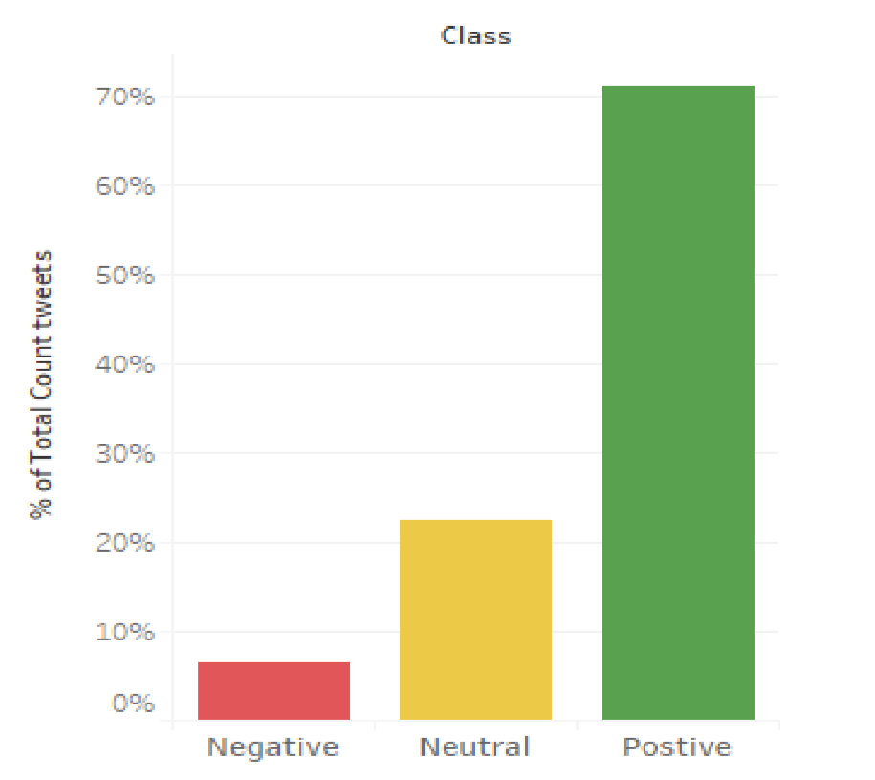
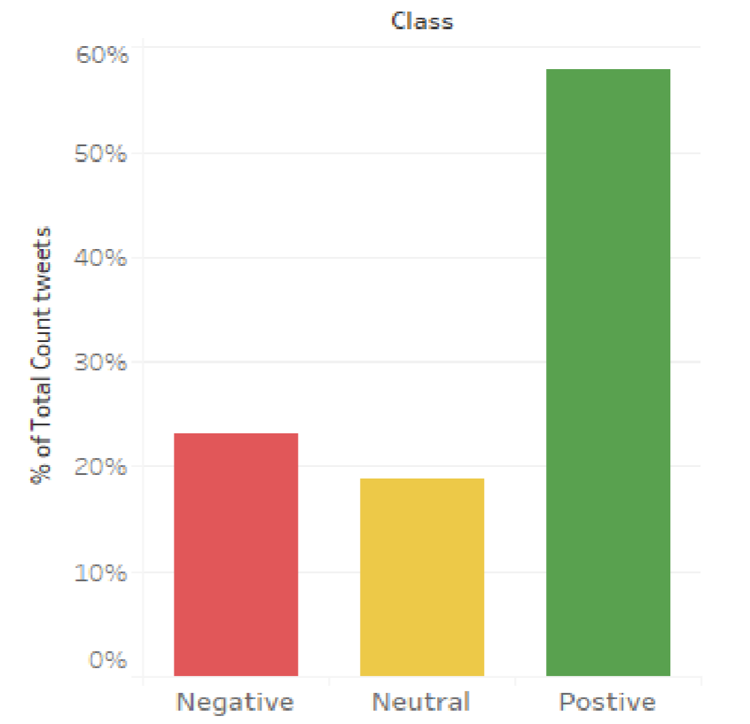
Tweets in Which User Name Tagged
sentiment for @narendramodi used by people sentiment for @RahulGandhi used by people

Slide 26
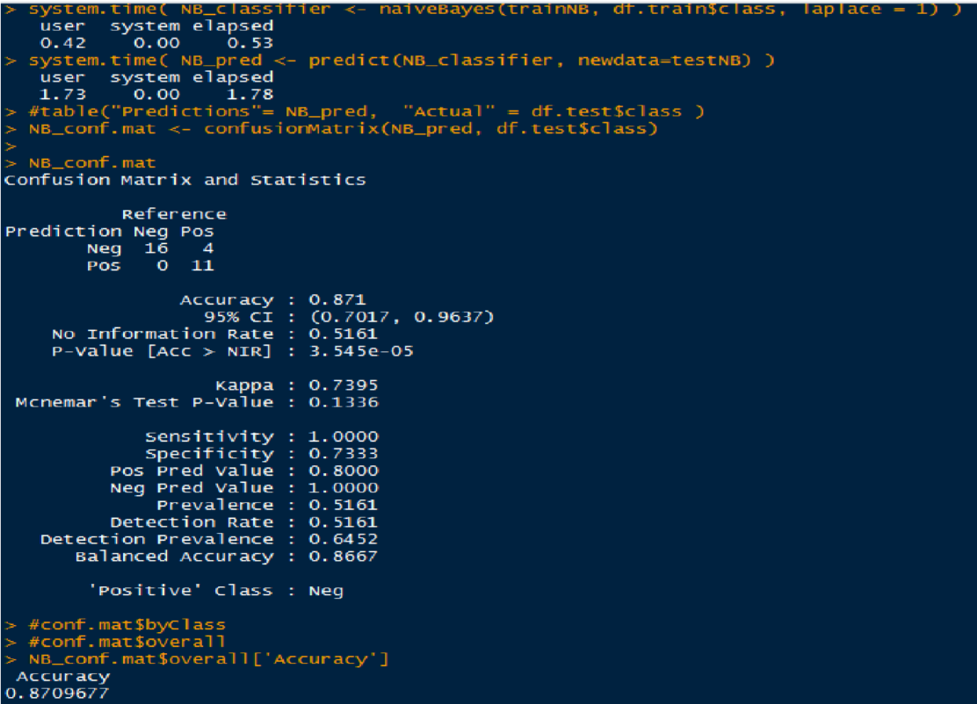
Model to predict tweet sentiment
Naïve Bayes:

Slide 27
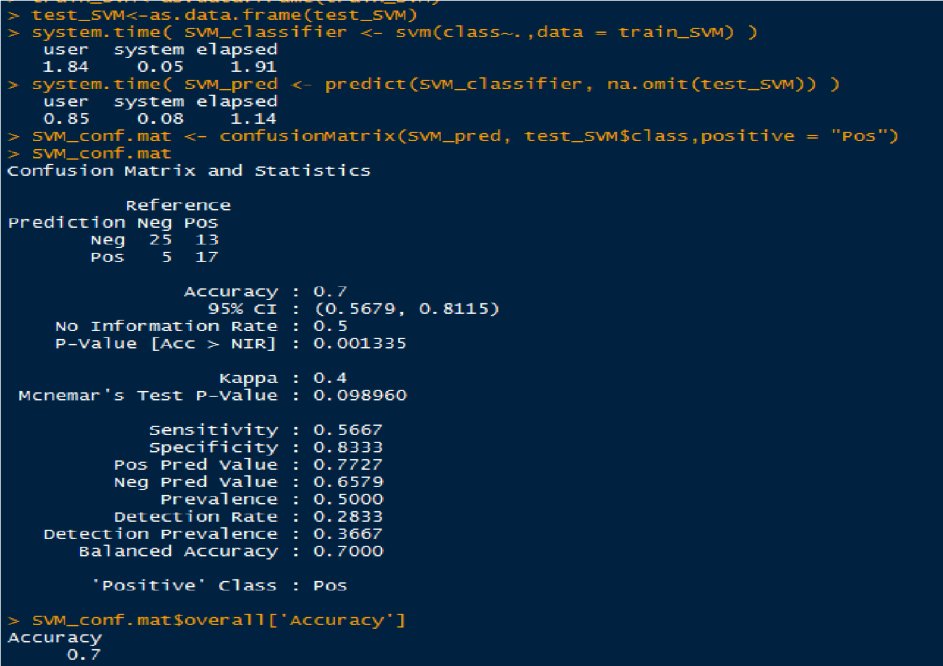
Support Vector Machine

Slide 28
Conclusion
As per the analysis result we found that Narendra Modi is far away to Rahul Gandhi in terms of no of tweets, positive sentiment tweets, favorite count on tweets, and retweets count. And Narendra mod has only 6% negative sentiment out of 3200 and Rahul Gandhi has 23%. And this huge difference is just because the Narendra Modi currently ruling the country and Rahul Gandhi currently in opposition so that one of the major reason of negative sentiment because he usually criticize the government policies.
We also try to find the people opinion on Narendra Modi and Rahul Gandhi by analyzing the tweets which have the string @narendramodi and @RahulGandhi (Twitter user name). The result show that around 71% opinion on Narendra Modi is positive and for Rahul Gandhi 58% positive tweets. But in the negative sentiment there is huge difference between these two leaders for Narendra Modi negative sentiments are 7% and for Rahul Gandhi it is 23%. So we can clearly say that on twitter Narendra Modi has better opinion in public mind. And one more result suggest that at time of election the retweets and favorite count is increasing rapidly for both the leaders so we can assume that people actively sharing the tweets of leaders during the election campaigning. That can be see as they are promoting their leader on social media. This sentiment analysis result are suggesting that Narendra Modi and his party have better positive opinion in public as compare to Rahul Gandhi and his party. And the result of election show the same result as well .

Slide 29
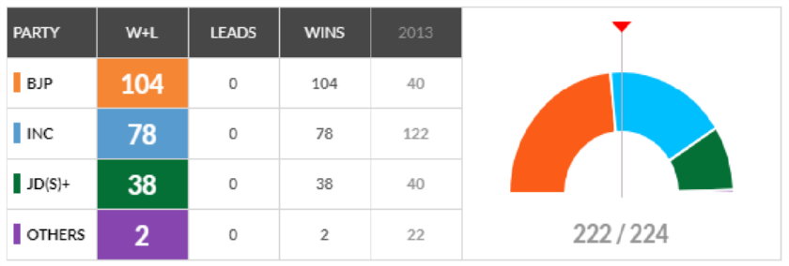
Conclusion (contd)
Karnataka assembly election result 2018

Slide 30
Future Work
Spam Detection: As in the second part we are using tweets for analysis. If we include and process the tweets though the spam detection method we can have more accurate sentiment analysis result.
More Data of Speeches: In this analysis we have only used 11 speeches of each leader.
And if we have more accurate data then we can have better results.
Include other social media data: We can also have data from other social media.
Because in this analysis we only use data from twitter.
Language Independent Technique: Improving proposed technique to work on Multilanguage’s in the scientific domain.
Proposing an additional evaluation: Proposing addition evaluations criteria to categorize the leaders on the basis of their speeches. We can implement this by using the sentiment score present in their speeches

Slide 31
Thank You

